Slide 1
Convolution neural network
Associate professor Faiz ul haque Zeya

Slide 2
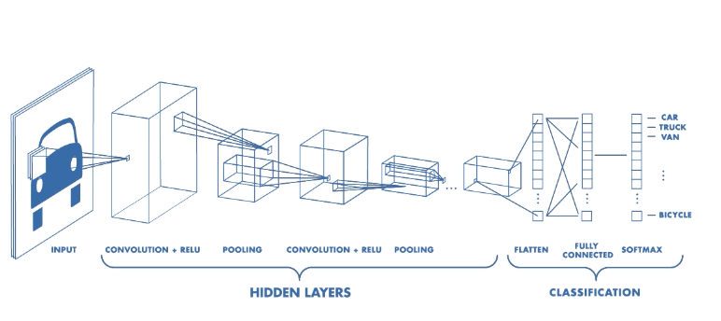

Slide 3
Convolution https://compsci682.github.io/notes/convolutional-networks/

Slide 4
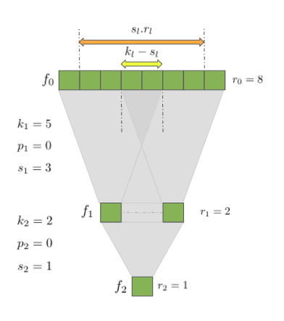
R l-1= sl rl+(kl-sl)
kernel size, stride, and padding. We’ll denote them as , and respectively.

Slide 5
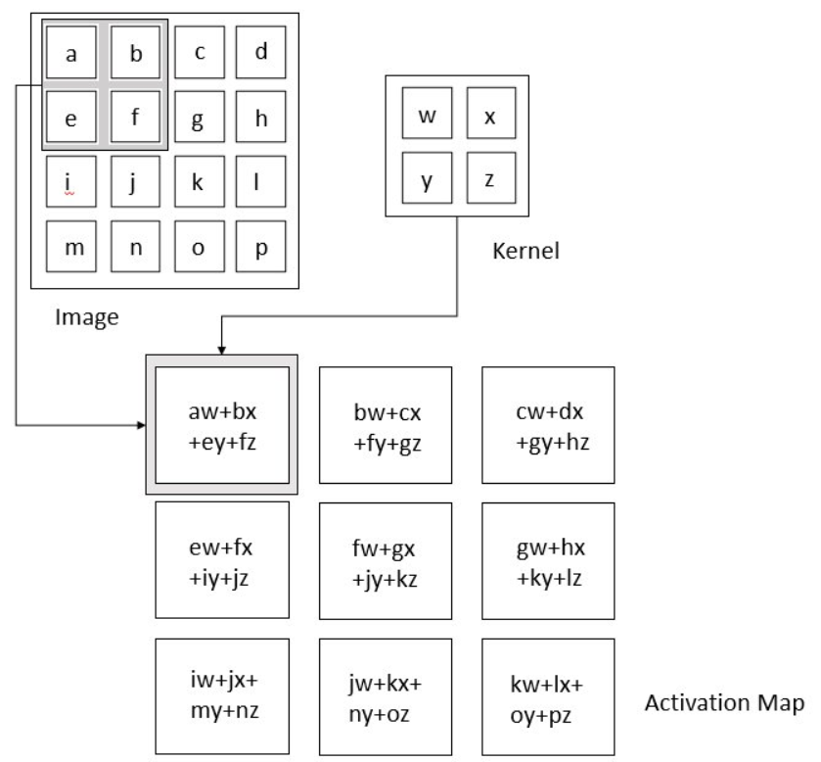

Slide 6
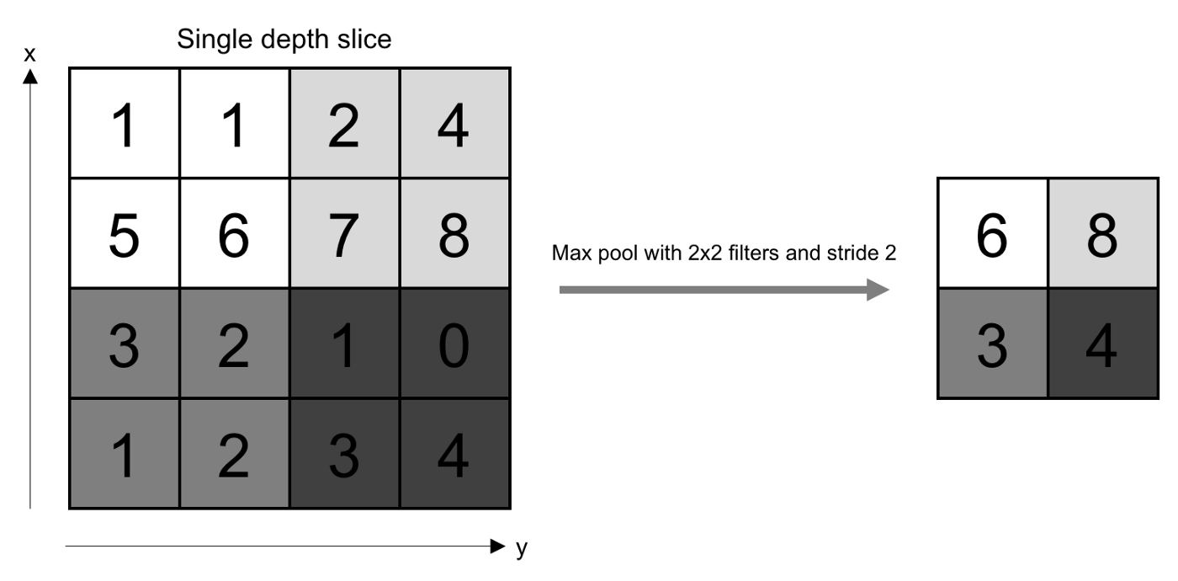
Max pool and average pool

